Slide 1
Data Analysis and Forecasting Approach

Slide 2
Summary
220 KV data is shared for two years starting from Dec. 2023 to Nov. 2025 – data is at 1 hour granularity
Data is highly fluctuating
Demand is a function of residential, commercial and agricultural loads
In the Kuppam geography, it seems agricultural loads dominates and has been observed that the total load is higher during the crop seasons
Long-term forecasting approach is proposed and implemented considering climate and macro-economic indicators and demand auto-regressive features

Slide 3
Observations
Higher energy consumption is observed in rainy season and as well as post rainy season
Kuppam demand seems to have major consumption from agriculture
Higher demand is noticed in the following months (can be noticed in the graph in next slide)
  Kharif – June to October
  Rabi – Nov. To Mar

Slide 4
Monthly Aggregate Consumption –220 KV SS
Agricultural load due to crop season
2024
2025

Slide 5
Monthly Aggregates based on Revenues
Residential - 1
Commercial - 2
Industrial - 3 + 4
Agriculture - 5
Others - 6 + 7B
HT Industrial - SPDCL

Slide 6
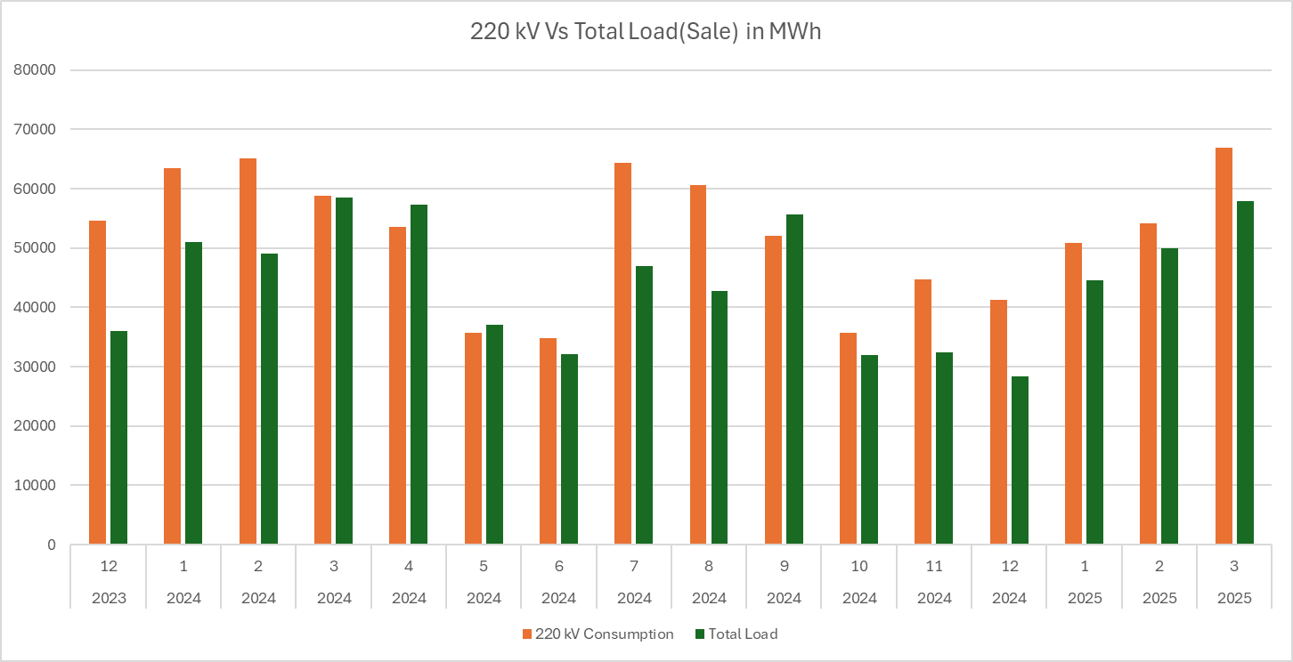
Comparison between 220 kV load and Monthly data

Slide 7
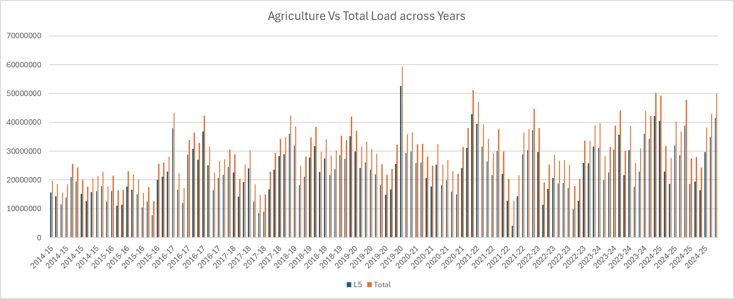
Agricultural Load Impact on Total Load

Slide 8
Correlation Matrix – Features Importance
 | Total | Tmax_C | Tmin_C | Rain_mm | Rain_pct | Sun_hrs | Wind_kmh
Total | 1.00 | 0.21 | -0.06 | -0.31 | -0.32 | 0.31 | 0.00
Tmax_C | 0.21 | 1.00 | 0.77 | -0.09 | -0.03 | 0.30 | 0.15
Tmin_C | -0.06 | 0.77 | 1.00 | 0.44 | 0.54 | -0.34 | 0.34
Rain_mm | -0.31 | -0.09 | 0.44 | 1.00 | 0.96 | -0.68 | -0.17
Rain_pct | -0.32 | -0.03 | 0.54 | 0.96 | 1.00 | -0.79 | 0.04
Sun_hrs | 0.31 | 0.30 | -0.34 | -0.68 | -0.79 | 1.00 | -0.47
Wind_kmh | 0.00 | 0.15 | 0.34 | -0.17 | 0.04 | -0.47 | 1.00

Slide 9
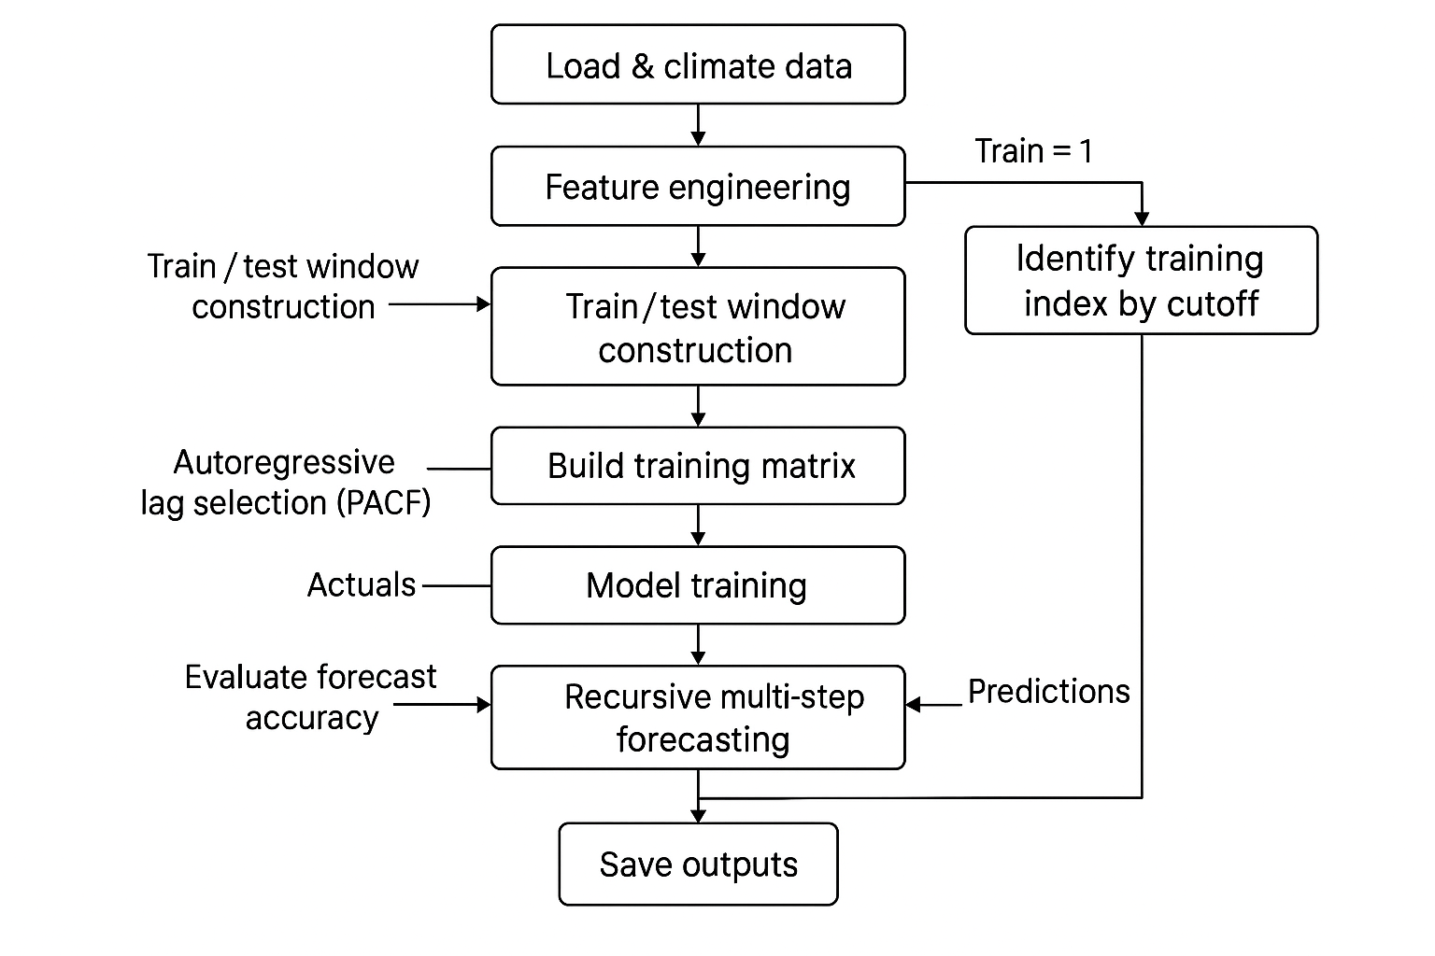
Forecasting Approach

Slide 10
Methodology
Goal: Accurate monthly/peak load forecasts with climate + AR structure
Data Inputs
  Load by category (monthly/hourly)
  Climate: Tmax, Tmin, Rain, Sun_hrs, Wind; engineered Rain_Lag1, Rain_Lag1_sq
  Macro: PCI (per‑capita income)
  Dummies: rFlag (high‑rain), optional peak helpers (Heatwave/Humidity/Weekend/Festival)
Feature Engineering
  Climate + macro + dummies
  Autoregressive (AR) lags selected via PACF to capture persistence/seasonality
Model
  Random Forest Regressor (robust, nonlinear), easy swap to GBM for quantiles

Slide 11
Forecasting Loop → Evaluation → Outputs
Rolling/Recursive Forecasting
Predict in blocks (Step size = 6 months): can be modified by user
  Build X_test = (future climate + current AR lags)
  Predict, write predictions back to series for next AR computation
  Advance window and repeat until horizon completes
  Evaluation (Train=1)
Compare Predictions vs Actuals over horizon
Report MAPE (and optionally sMAPE/Pinball loss for quantiles)
Deliverables
Load_Forecast.csv: monthly predictions per category (aligned to TestDates)
Load_Actuals.csv: (when Train=1) for quick backtest review
Correlation heatmap & feature list aid explainability

Slide 12
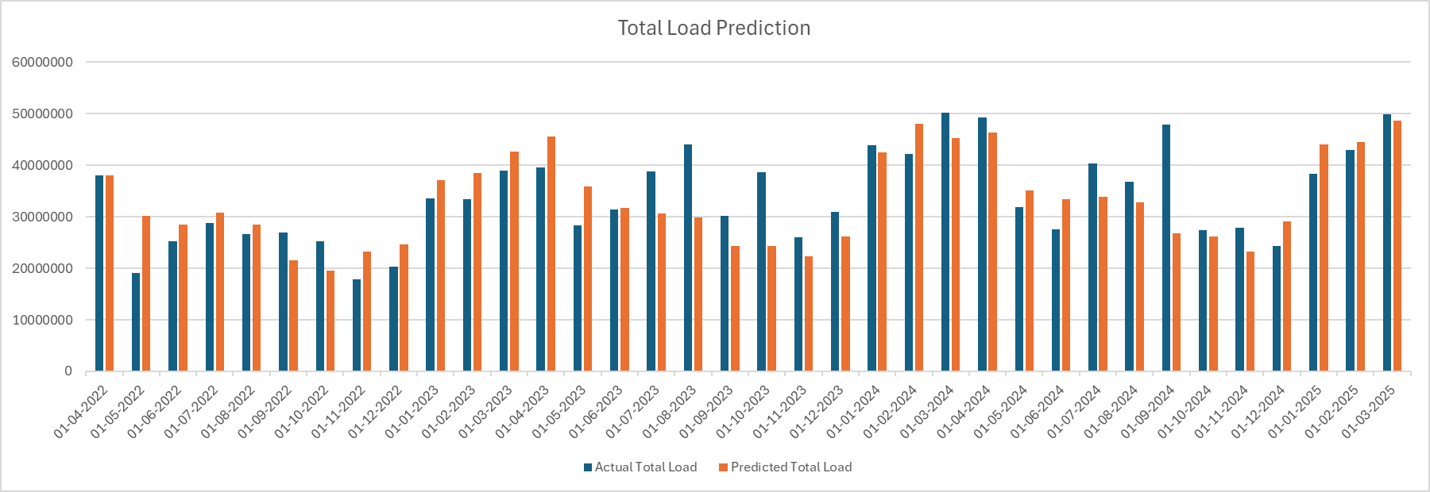
Total Load – Monthly Forecasts ( 3 years ahead)

